Slide 1
Overwatch Event Planner
Does what it says, A lesson in the importance of planning

Slide 2
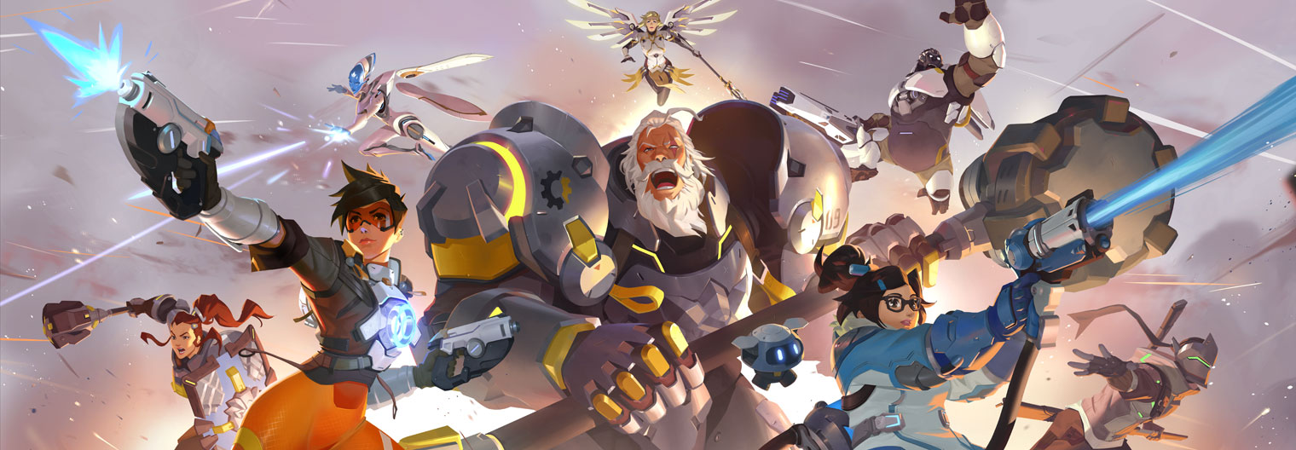
If your not familiar with Overwatch
Overwatch is a video game, the game is objective based and two teams of super heroes battle for control.
Highly competitive, when your progress past a casual player the competitive scene for the game is active
I used to run a Esport organization that would plan events and tournaments
Planning the event bracket is very tedious i wanted to build an app that would automate that

Slide 3
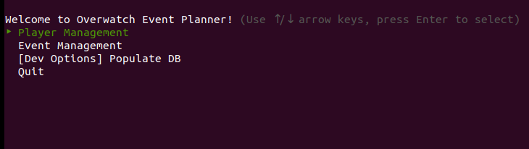
Interface
Menu input means there is little chance for user input error.
Gem : tty-prompt

Slide 4
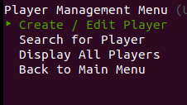

Creating a database using YAML
Tty-prompt is useful because it can validate user input for you. I didn’t have time but if i could go back and change this i would edit the error message to be more user friendly.
The app asks a series of relevant questions to intialize a Player class object which i then store in a hash { player.id => player_object} which then gets stored in a .yml file which saves the data after the app has been closed

Slide 5
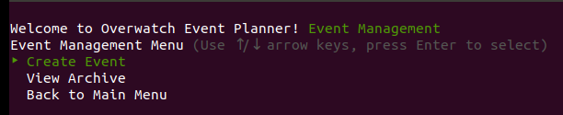
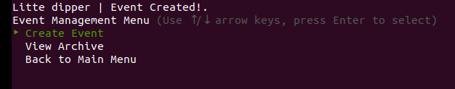
Using the data gathered to create an event
Once the relevant data has been captured, we loop through the data base to create teams and split them into divisions. I used the Faker gem to generate random interesting names

Slide 6
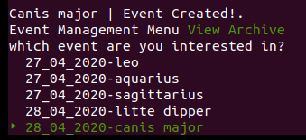
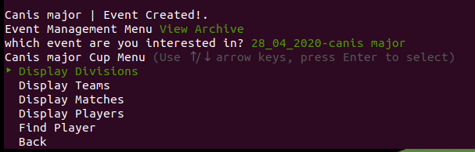
Viewing event info
After create the event which is stored as an event object in a database similar to the players and through another menu interface we can access the data

Slide 7
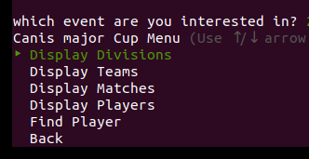
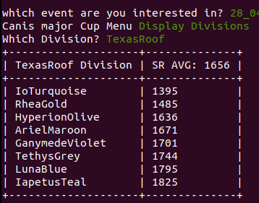
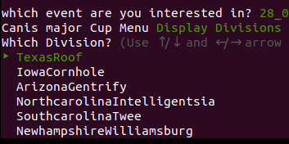
Text-table gem for print out
The gem provides an easy method for generating text based tables for information print outs

Slide 8
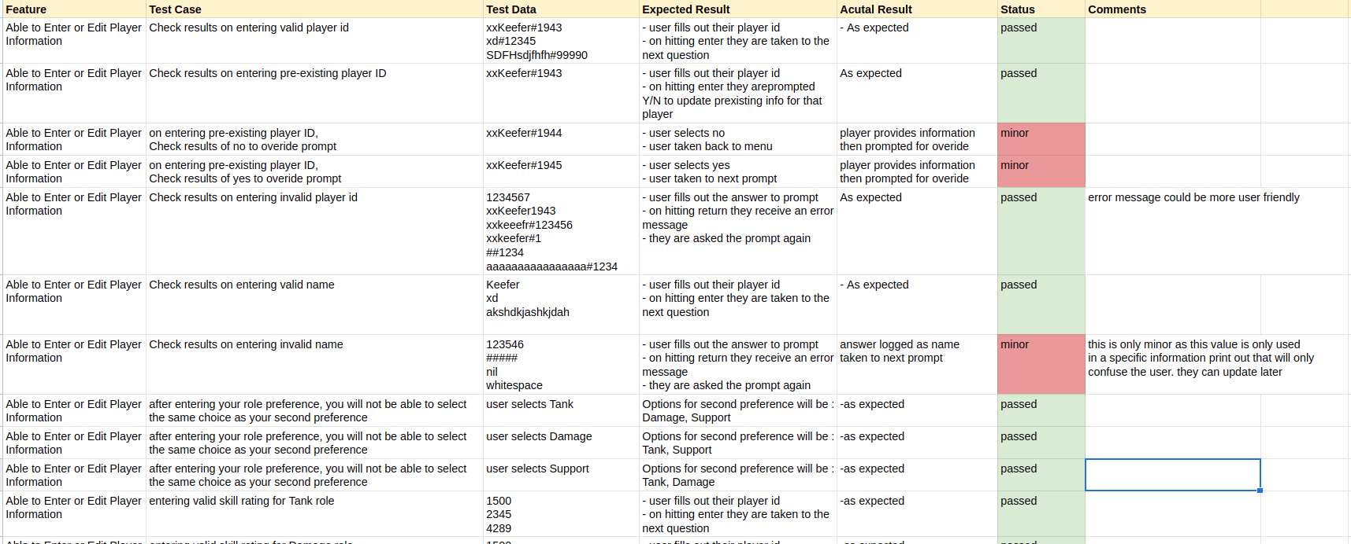
Lesson learnt.
I started coding before planning as i was unsure of how to do this. It clicked to late what i should have done. As a result the complexity of matching players into teams and divisions was a lot harder than i thought initially and i ran out of time to fix a lot of the bugs.

Slide 9
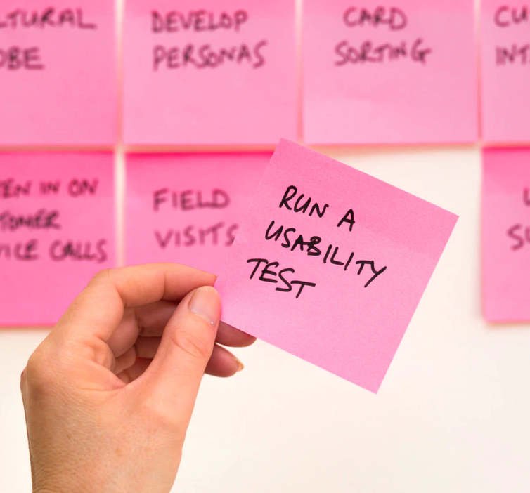
What i’ll do next time
Write user stories, from these user stories i’ll know what functions i’ll need to create
Knowing the functions i need to create, i will write tests for them first
I will then write the code and COMMIT after i have written a function that passes the test

Slide 10

User Stories
It all clicked (a little too late) what user stories were supposed to be when i stumbled across this article from Atlassian, the guys who develop trello. User Stories | Examples and Template
The template goes: As a [TYPE OF USER], I want [TO DO SOMETHING], so that [I CAN ACHIEVE A GOAL] or As a, I want, So that
Knowing what you users are trying to achieve will immediately give direction on what functions you need, and what tests they need to pass.

Slide 11
Thanks for listening
:DDDDDDDDDDDDDDDDDDDDDDDDDDDDDDDDDDDDDD

